Slide 1



INTERNSHIP REVIEW -01
GOWTHAM P

Slide 2
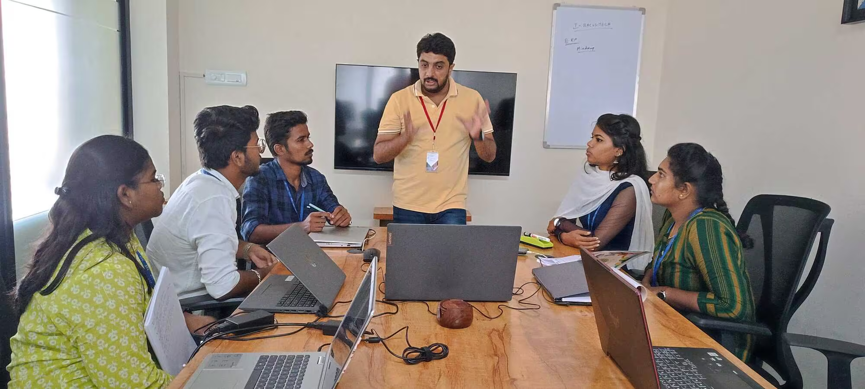
A HISTORY OF ORGANISATION
I BACUS TECH, a leading digital transformation company based in India, dedicated to revolutionizing businesses worldwide. With our innovative solutions and cutting-edge technologies, we specialize in driving growth and success for companies across various industries. From startups to Fortune 500 corporations, our transformative approach has helped organizations in India, USA, Canada, UAE,
.Our team of experts combines industry knowledge with technical expertise to deliver customized solutions tailored to meet the unique needs and objectives of each client. Whether it's implementing AI-driven automation, developing intuitive mobile applications, or optimizing cloud infrastructure, we empower businesses to adapt, evolve, and stay ahead of the competition.
I BACUS TECH is your trusted partner in digital transformation. Join us on the journey to success and discover how our innovative solutions can propel your business to new heights in today's rapidly changing digital landscape. Unlock the power of digital transformation with I BACUS TECH – where innovation meets excellence.
EXPERIENCE
10+ years of Industry Experience
PRESENCE
Our Services are present in 5 continents
ACHIEVEMENTS
5000+ Interns Trained

Slide 3


ORGANISATIONAL PROFILE
LOCATION: COIMBATORE, TAMIL NADU, INDIA
INDUSTRY: INFORMATION TECHNOLOGY, DATA ANALYTICS, BUSINESS INTELLIGENCE, SOFTWARE DEVELOPMENT
FOUNDED: 2014
FOUNDER AND DIRECTOR:DHANESH P K
MANAGER: BALAJI S

Slide 4
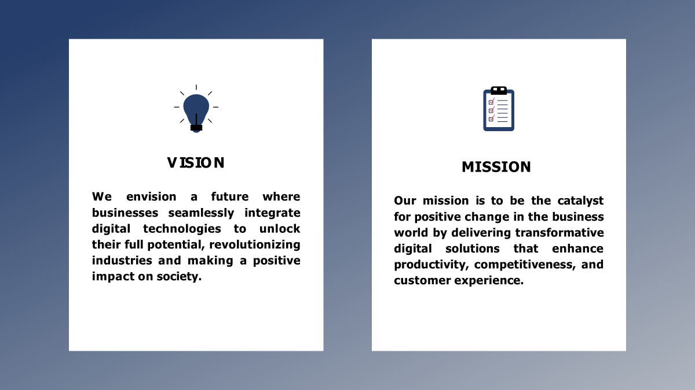

Slide 5
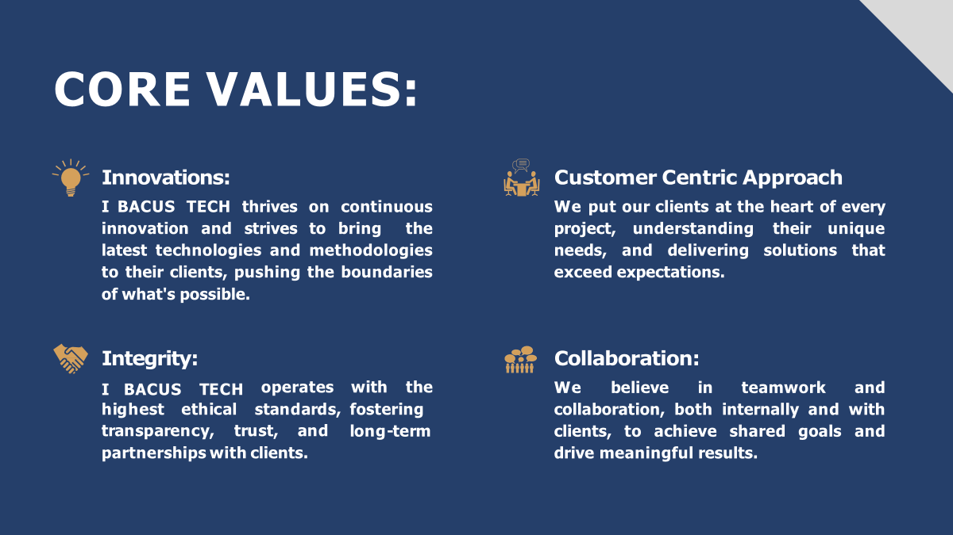

Slide 6

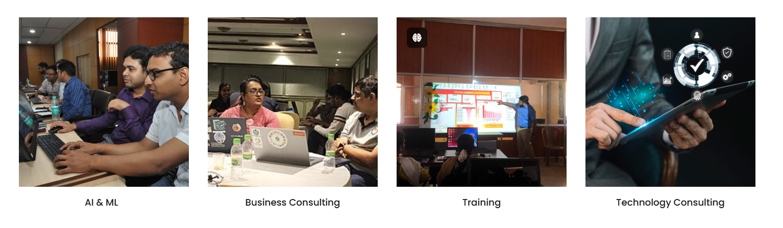
SERVICES

Slide 7


Slide 8
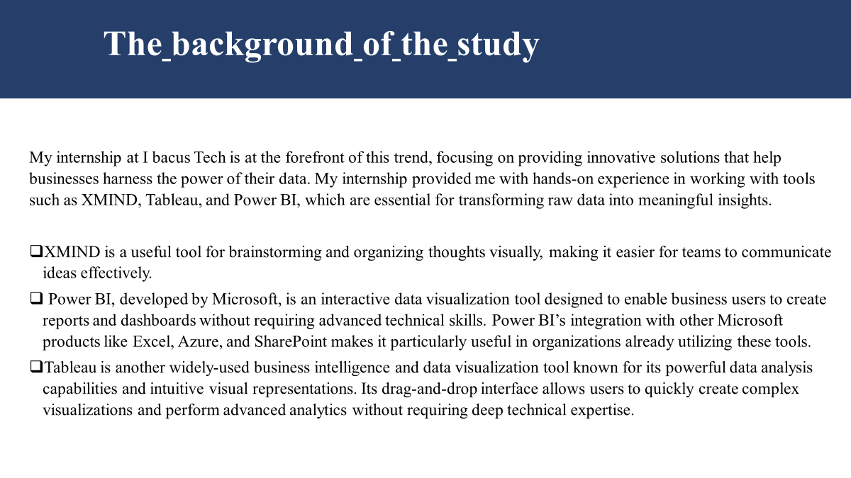

Slide 9
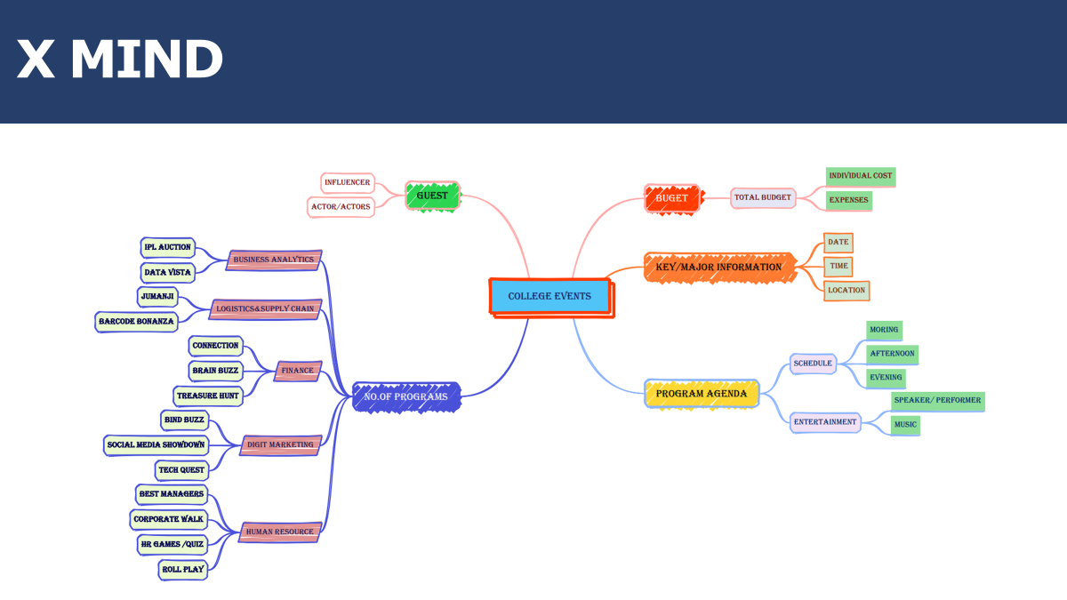


Slide 10
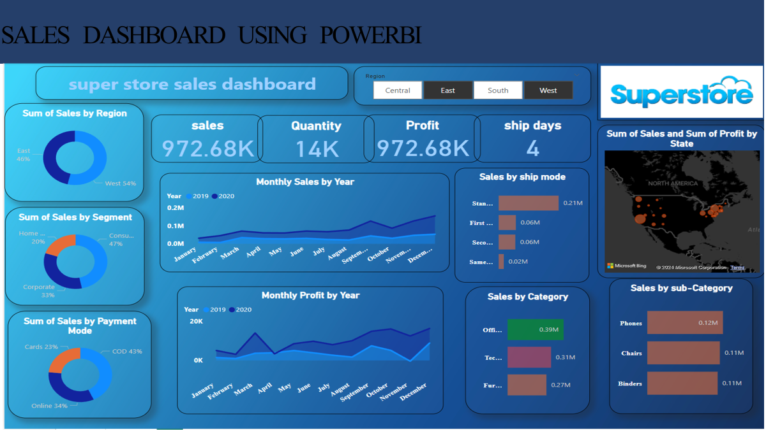


Slide 11
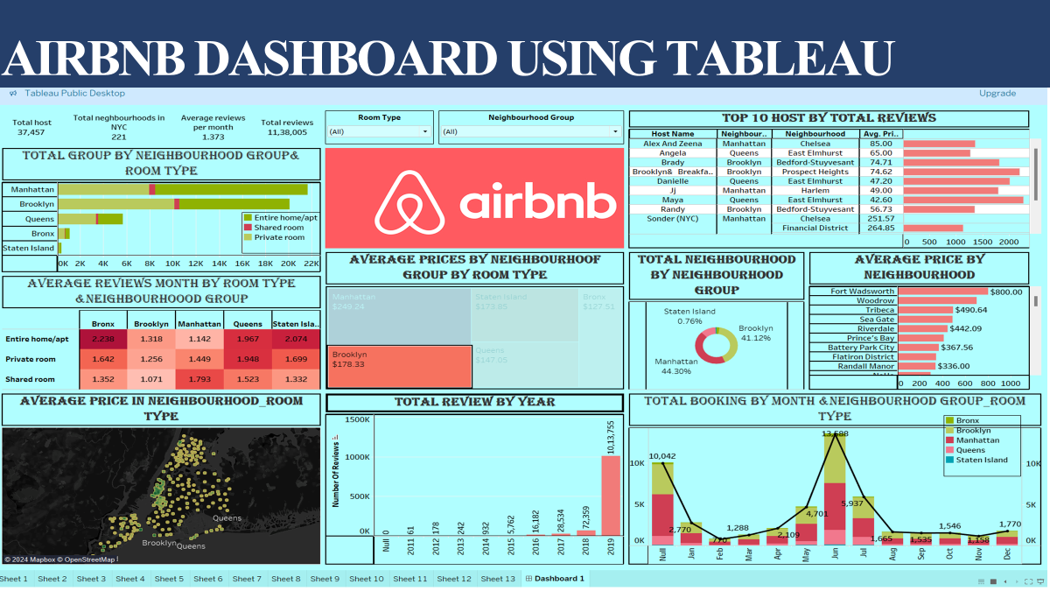


Slide 12
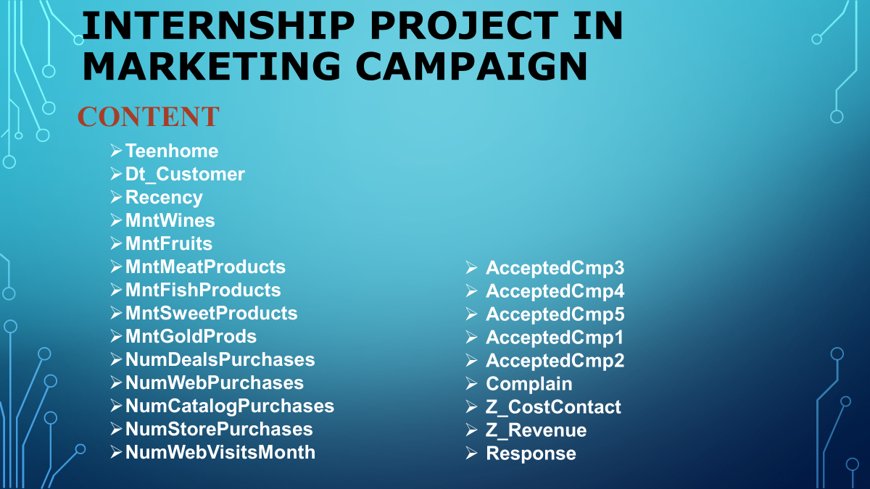


Slide 13
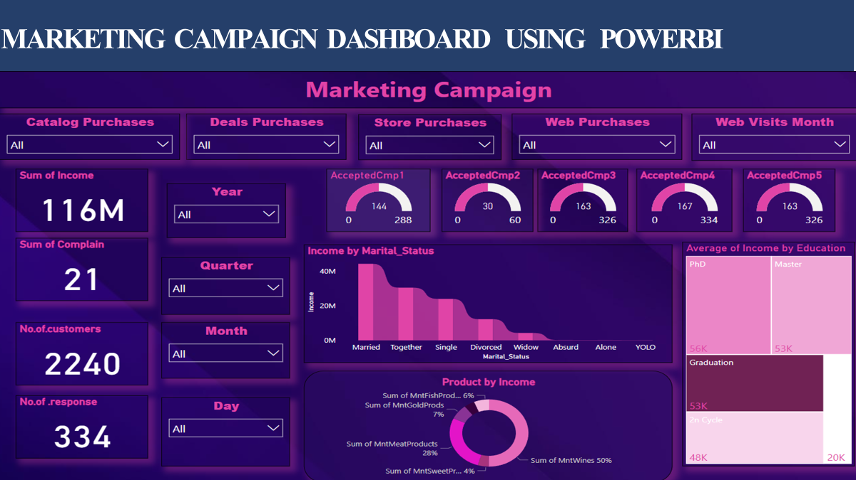

Slide 14
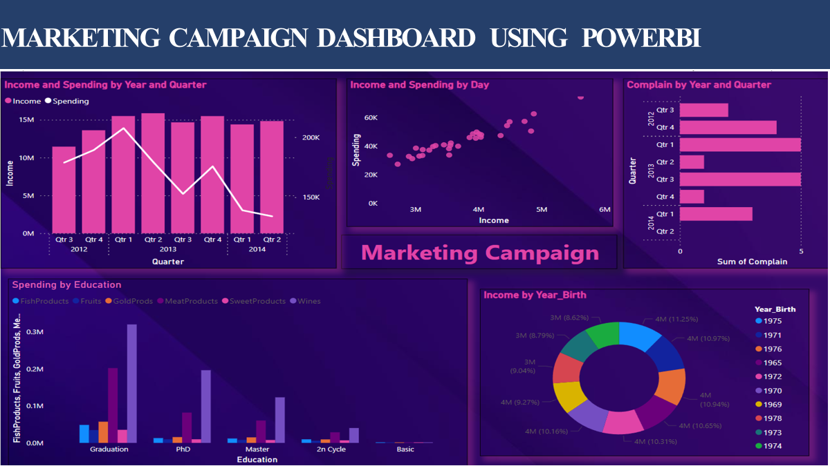

Slide 15
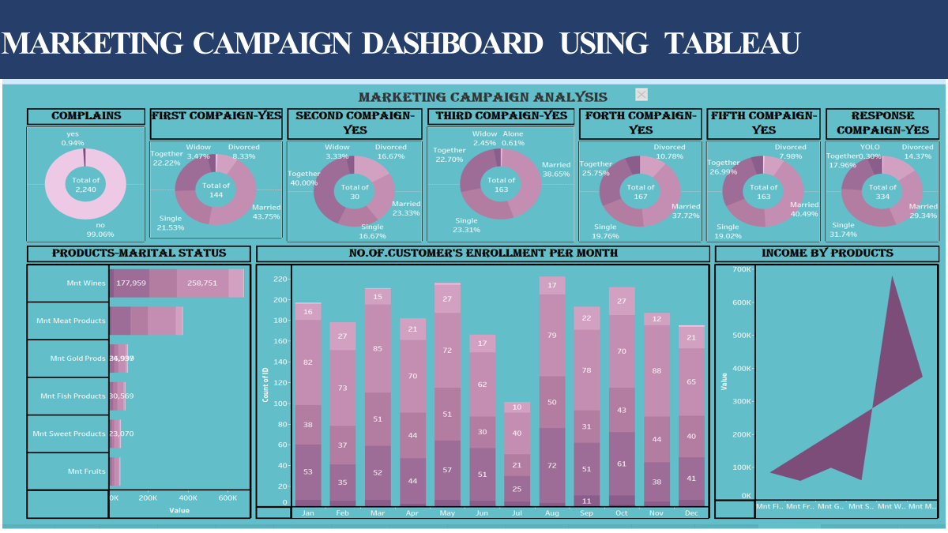

Slide 16
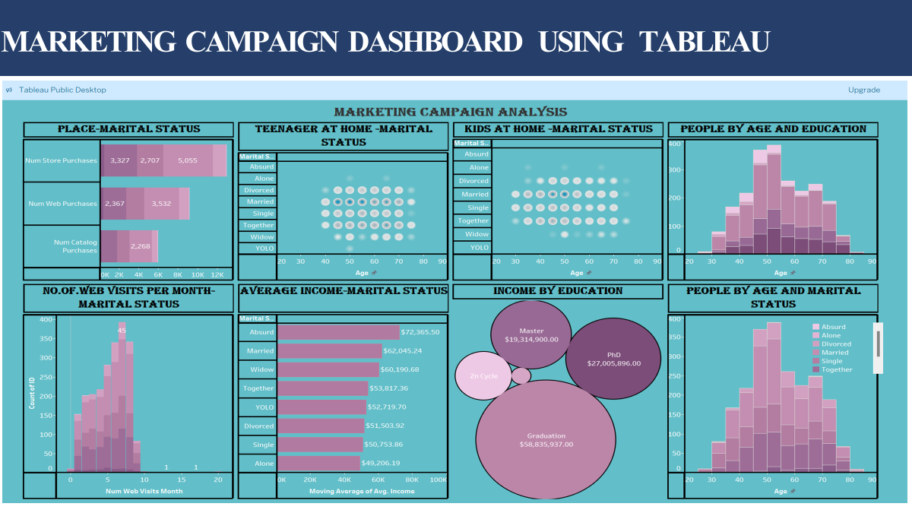

Slide 17


Slide 18

THANK YOU
“ I-BACUS-TECH IS YOUR TECHNOLOGICAL PARTNER; IT’ S TIME TO MODERNIZE YOUR BUSINESS.”

